Slide 1
Multi-omics Boot Camp
Analysis of Omics Data for Research Studies
Mediation

Slide 2
Goals
Understand the concept of mediation analysis and its application in omics study (for this lecture we have individual-level data!)
Understand the statistical modeling of different mediation analysis frameworks, including
Simple mediation analysis (one exposure, one mediator, and an outcome)
Analysis with multiple mediators.
Analyses with multiple exposure.
Approaches that estimate latent variables.
LUCID
Apply the methods mentioned above in R and be able to interpret the results.

Slide 3
No Mediation Model
Does exposure to organochlorines (a chemical compound in pesticides) influence obesity in children (Y)?
X
Y

Slide 4
Complete Mediation
Does exposure to organochlorines (X) influence insulin levels (M) that then alter levels of obesity in children (Y)?
M
X
Y

Slide 5
(Partial) Mediation Model
Does exposure to organochlorines (X) influence insulin levels (M) that then alter levels of obesity in children (Y)?
M
X
Y
Does exposure to organochlorines (X) alter levels of obesity in children (Y)?

Slide 6
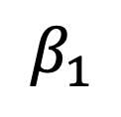
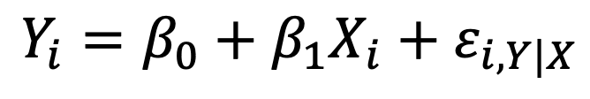
Mediation: Step 1
Characterize the total effect: the association of the risk factor (X) to the outcome (Y).
$$β_{1}$$
X
Y
$$Y_{i}=β_{0}+β_{1}X_{i}+ε_{i,Y|X}$$

Slide 7
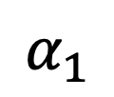
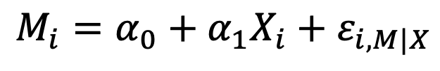
Mediation: Step 2
M
$$M_{i}=α_{0}+α_{1}X_{i}+ε_{i,M|X}$$
$$α_{1}$$
X
Establish association between
the risk factor (X) and the
mediator (M); one component of indirect effect.

Slide 8
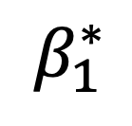
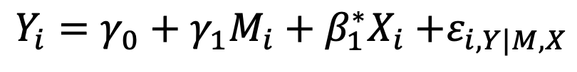
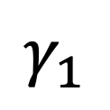
Mediation: Step 3
Characterize the direct effect and estimate the other component of the indirect effect:
M
$$γ_{1}$$
X
Y
$$β_{1}^{∗}$$
$$Y_{i}=γ_{0}+γ_{1}M_{i}+β_{1}^{∗}X_{i}{+ε}_{i,Y|M,X}$$

Slide 9
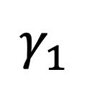
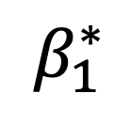
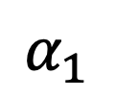
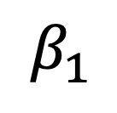
Mediation: Compare Total Effect to Direct and Indirect Effect
M
$$α_{1}$$
$$γ_{1}$$
X
Y
X
Y
$$β_{1}$$
$$β_{1}^{∗}$$

Slide 10
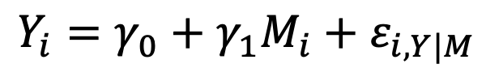
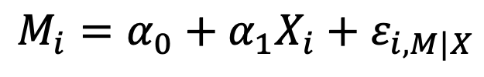
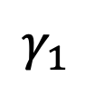
Calculating the Indirect Effect
M
$$M_{i}=α_{0}+α_{1}X_{i}+ε_{i,M|X}$$
$$Y_{i}=γ_{0}+γ_{1}M_{i}+ε_{i,Y|M}$$
$$α_{1}$$
$$γ_{1}$$
X
Y

Slide 11
Calculating the Indirect Effect
M
$$M_{i}=α_{0}+α_{1}X_{i}+ε_{i,M|X}$$
$$Y_{i}=γ_{0}+γ_{1}M_{i}+ε_{i,Y|M}$$
$$α_{1}$$
$$γ_{1}$$
X
Y

Slide 12
Calculating the Indirect Effect
M
$$M_{i}=α_{0}+α_{1}X_{i}+ε_{i,M|X}$$
$$Y_{i}=γ_{0}+γ_{1}M_{i}+ε_{i,Y|M}$$
$$α_{1}$$
$$γ_{1}$$
X
Y
$$Y_{i}=γ_{0}+γ_{1}(α_{0}+α_{1}X_{1}+ε_{i,M|X})+ε_{i,Y|M}$$

Slide 13
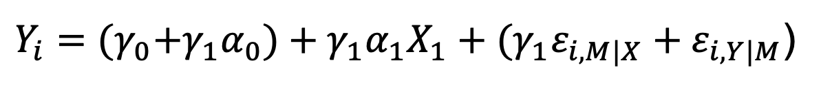
Calculating the Indirect Effect
M
$$M_{i}=α_{0}+α_{1}X_{i}+ε_{i,M|X}$$
$$Y_{i}=γ_{0}+γ_{1}M_{i}+ε_{i,Y|M}$$
$$α_{1}$$
$$γ_{1}$$
X
Y
$Y_{i}={(γ}_{0}+γ_{1}α_{0})+{γ_{1}α}_{1}X_{1}+{{(γ}_{1}ε}_{i,M|X}+ε_{i,Y|M}$)

Slide 14
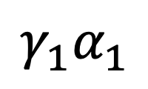
Calculating the Indirect Effect
M
$$M_{i}=α_{0}+α_{1}X_{i}+ε_{i,M|X}$$
$$Y_{i}=γ_{0}+γ_{1}M_{i}+ε_{i,Y|M}$$
$$α_{1}$$
$$γ_{1}$$
X
Y
$${γ_{1}α}_{1}$$
Indirect Effect:

Slide 15
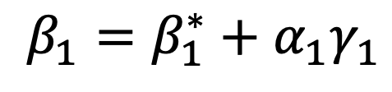
Mediation: Compare Total Effect to Direct and Indirect Effect
$$β_{1}=β_{1}^{∗}+α_{1}γ_{1}$$
M
$$α_{1}$$
$$γ_{1}$$
X
Y
X
Y
$$β_{1}$$
$$β_{1}^{∗}$$

Slide 16
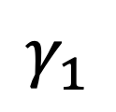
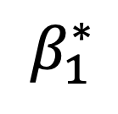
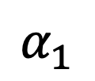
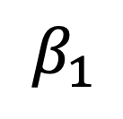
No Indirect Effect
0
$$β_{1}=β_{1}^{∗}+α_{1}γ_{1}$$
M
$$α_{1}$$
$$γ_{1}$$
X
Y
X
Y
$$β_{1}$$
$$β_{1}^{∗}$$

Slide 17
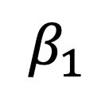
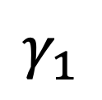
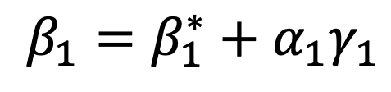
Complete Mediation
0
$$β_{1}=β_{1}^{∗}+α_{1}γ_{1}$$
M
$$α_{1}$$
$$γ_{1}$$
X
Y
X
Y
$$β_{1}$$

Slide 18
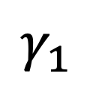
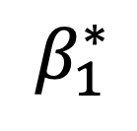
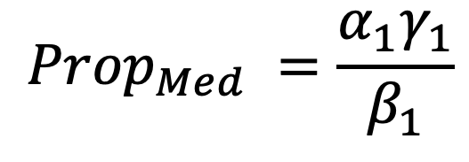
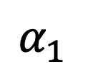
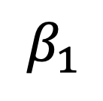
Proportion of Mediation
$${Prop}_{Med} =\frac{α_{1}γ_{1}}{β_{1}}$$
M
$$α_{1}$$
$$γ_{1}$$
X
Y
X
Y
$$β_{1}$$
$$β_{1}^{∗}$$

Slide 19
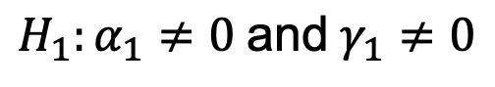
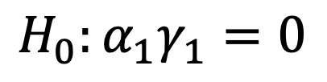
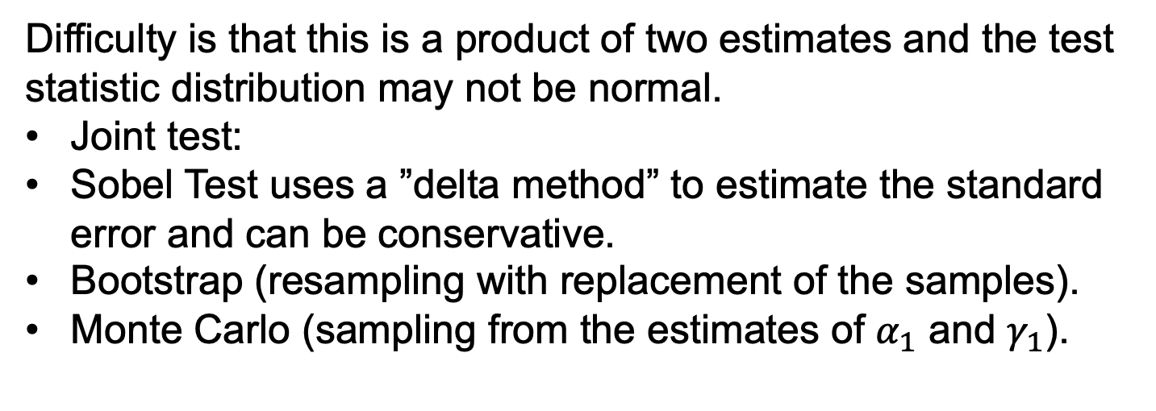
Test of Mediation
$${H_{0}:α}_{1}γ_{1}=0$$
Difficulty is that this is a product of two estimates and the test statistic distribution may not be normal.
Joint test:
Sobel Test uses a ”delta method” to estimate the standard error and can be conservative.
Bootstrap (resampling with replacement of the samples).
Monte Carlo (sampling from the estimates of $α_{1}$ and $γ_{1}$).
$${H_{1}:α}_{1}≠0 \text{and} γ_{1}≠0$$

Slide 20
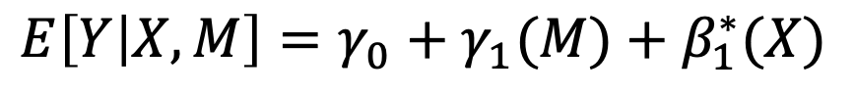
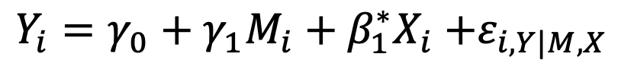
Comment on Causal Mediation
In causal analysis we “fix” the value of the exposure/mediator and compare the difference in the expectation of the outcome based on two ”fixed” values for the exposure/mediator.
M
$$Y_{i}=γ_{0}+γ_{1}M_{i}+β_{1}^{∗}X_{i}{+ε}_{i,Y|M,X}$$
X
Y
$$E\left[Y | X,M\right]=γ_{0}+γ_{1}(M)+β_{1}^{∗}(X)$$

Slide 21
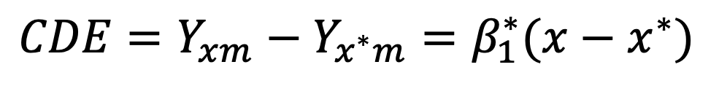
Comment on Causal Mediation
Fix X=x and compare to X=x*, while holding a mediator constant at M=m (setting mediator to the value of m):
$$E[Y\left|X=x,M=m\right]=γ_{0}+γ_{1}m+β_{1}^{∗}x=Y_{xm}$$
$$E[Y\left|X=x^{∗},M=m\right]=γ_{0}+γ_{1}m+β_{1}^{∗}x^{∗}=Y_{x^{∗}m}$$
Controlled direct (and natural direct) effect:
${CDE=Y}_{xm}−$ $Y_{x^{∗}m}=β_{1}^{∗}(x−x^{∗})$
Measures the effect of X on Y not mediated through M,
i.e. the effect of X on Y after intervening to fix the mediator to some value m.

Slide 22
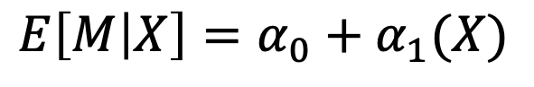
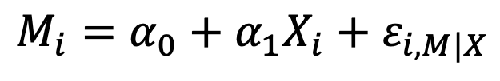
Comment on Causal Mediation
In causal analysis we “fix” the value of the exposure/mediator and compare the difference in the expectation of the outcome based on two ”fixed” values for the exposure/mediator.
M
$$Y_{i}=γ_{0}+γ_{1}M_{i}+β_{1}^{∗}X_{i}{+ε}_{i,Y|M,X}$$
X
Y
$$E\left[Y | X,M\right]=γ_{0}+γ_{1}(M)+β_{1}^{∗}(X)$$
M
$$M_{i}=α_{0}+α_{1}X_{i}+ε_{i,M|X}$$
X
$$E\left[M | X\right]=α_{0}+α_{1}(X)$$

Slide 23
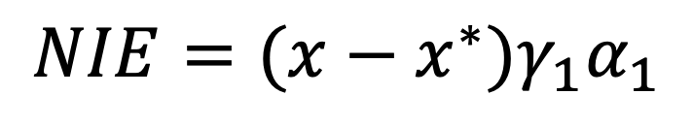
Comment on Causal Mediation
Following similar arguments, the natural indirect effect is:
$${{NIE=(x−x^{∗})γ}_{1}α}_{1}$$
Exposure set to compare:
What would have happened if the mediator were set to what it would have been if exposure had been x
Compare to what would have happened if the mediator were set to what it would have been if exposure had been x*

Slide 24
Reverse Causation
Potential solutions:
Time specific measurements (X measured before M measure before Y).
Switch Y and M and re-test.
Rule out reverse causation with a priori knowledge.
M
X
Y

Slide 25
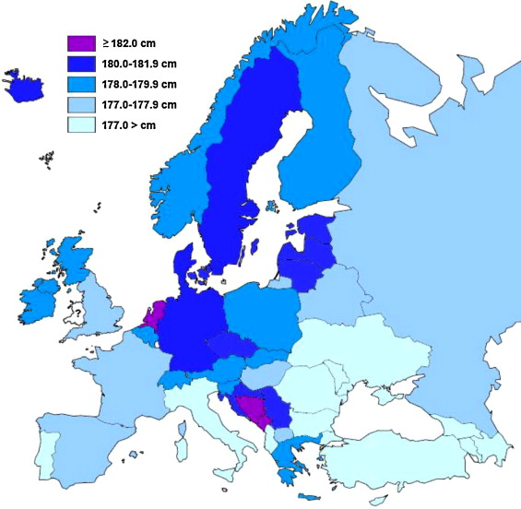
Compare to Confounding
Population
C
X
Y
SNP
Height
Grasgruber et al. Economics & Human Biology. 2014.
Novermbre et a. Nature. 2008

Slide 26
Confounding In Regression
Adjusted model:
Unadjusted model:
Greenland, et al. Epidemiology 1999.
Ankan et al. Curr Protoc. 2021.

Slide 27
Other issues
Each model is correctly specified.
For controlled effects, no unmeasured confounders for:
Exposure-outcome
Mediator-outcome
For natural effects (those above plus):
No unmeasured confounders for exposure-mediator
Exposure does not cause a confounder of the mediator-outcome.
Extensions:
Interactions with other variables.
Situations where the mediator can interact with the exposure (mediator-moderator).

Slide 28

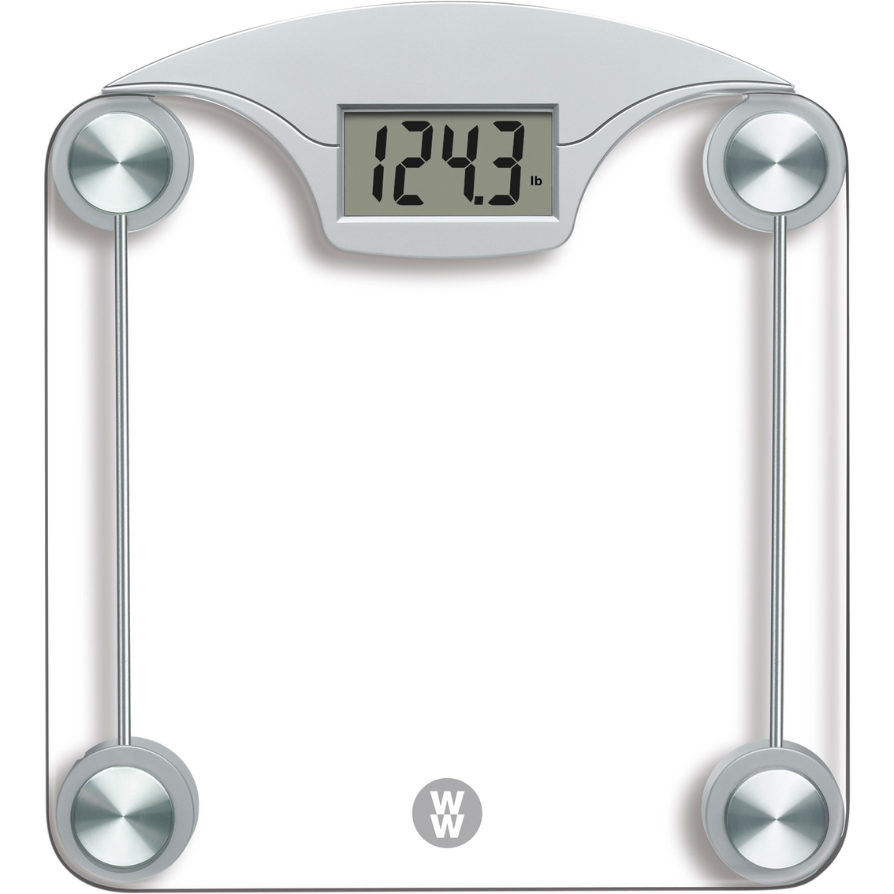
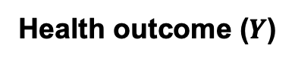
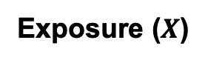
Why use mediation analysis for omics data?
Statistical Association
Organochlorines
Body mass index
Exposure ($X$)
Health outcome ($Y$)

Slide 29
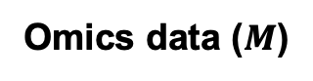
What is the underlying biological process?
Omics data ($M$)
Proteomics
Methylation
Metabolomics
Organochlorines
Body mass index
Exposure ($X$)
Health outcome ($Y$)

Slide 30
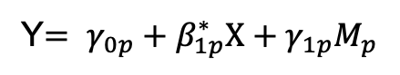
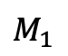
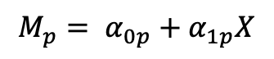
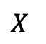
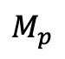
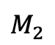
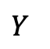

Mediation Analysis with Multiple Mediators
Mediator Model
(Separate model for all mediators)
Outcome Model
(Multiple separate models for all mediators)
$$M_{p}= α_{0p}+α_{1p}X$$
Y$= γ_{0p}+β_{1p}^{∗}X+γ_{1p}M_{p}$
$$M_{1}$$
$$M_{2}$$
……
$$M_{p}$$
$$X$$
$$Y$$
I$ndirect Effect= \sum_{p=1}^{P}{α_{1p}γ_{1p}}$
Assume mediators are independent of one another
(conditional on X and covariates included in the model)

Slide 31



Mediation Analysis with Multiple Mediators
Mediator Model
(Separate model for all mediators)
Outcome Model
(Single model for all mediators)
$$Y= γ_{0}+β_{1}^{∗}X+\sum_{p=1}^{P}{γ_{1p}M_{p}}$$
$$M_{p}= α_{0p}+α_{1p}X$$
$$M_{1}$$
$$M_{2}$$
……
$$M_{p}$$
$$X$$
$$Y$$
I$ndirect Effect= \sum_{p=1}^{P}{α_{1p}γ_{1p}}$
Note that these $γ_{p}$s are conditional on other mediators,
This accounts for potential inter-mediation effects ($M_{1}→M_{2}$).
Vanderweele and Vanstelelandt 2014

Slide 32

High Dimensional Mediation Analysis (HIMA)
Mediator Model
(Separate model for all mediators)
Outcome Model
(Single model for all mediators)
$$Y= γ_{0}+β_{1}^{∗}X+\sum_{p=1}^{P}{γ_{1p}M_{p}}$$
$$M_{p}= α_{0p}+α_{1p}X$$
$$M_{1}$$
$$M_{2}$$
……
$$M_{p}$$
$$X$$
$$Y$$
I$ndirect Effect= \sum_{p=1}^{P}{α_{1p}γ_{1p}}$
Note that these $γ_{p}$s are conditional on other mediators,
This accounts for potential inter-mediation effects ($M_{1}→M_{2}$).
Zhang et al. 2016

Slide 33
High Dimensional Mediation Analysis (HIMA)
Feature selection for mediators:
Screening step via “Sure Independence Screening” (SIS): identify a subset of the mediators that are among the top largest effects. Identify a set of K mediators.
Outcome Model
(Single model for all mediators)
$$Y= γ_{0}+β_{1}^{∗}X+\sum_{p=1}^{P}{γ_{1p}M_{p}}$$
Zhang et al. 2016

Slide 34


High Dimensional Mediation Analysis (HIMA)
Feature selection for mediators:
Screening step via “Sure Independence Screening” (SIS): identify a subset of the mediators that are among the top largest effects. Identify a set of K mediators.
Regularized regression using MCP:
Outcome Model
(Single model for all mediators)
$$Y= γ_{0}+β_{1}^{∗}X+\sum_{p=1}^{P}{γ_{1p}M_{p}}$$
$$\min_{γ}\left\{\frac{1}{N}{\left\|Y−γ_{0}+β_{1}^{∗}X+\sum_{k∈K}{γ_{1k}M_{k}}\right\|}_{2}^{2}+\sum_{k∈K}{p_{λ,δ}{(γ}_{1k})}\right\}$$
$λ$> 0 regularization parameter
$δ$ > 0 concavity of MCP
Zhang et al. 2016

Slide 35
High Dimensional Mediation Analysis (HIMA)
Feature selection for mediators:
Screening step via “Sure Independence Screening” (SIS): identify a subset of the mediators that are among the top largest effects. Identify a set of K mediators.
Regularized regression using MCP:
Outcome Model
(Single model for all mediators)
$$Y= γ_{0}+β_{1}^{∗}X+\sum_{p=1}^{P}{γ_{1p}M_{p}}$$
Use MCP because this approach can select the correct model with probability tending to 1.
Zhang et al. 2016

Slide 36

High Dimensional Mediation Analysis (HIMA)
Joint significance test (Reject null of no mediation if both $γ_{k}$ and $α_{k}$ are significant.
Mediator-Outcome effect: Bonferroni corrected p-value using the number of mediators selected from MCP and estimates from MCP $→P_{corr,γ_{k}}$
Exposure-Mediator effect: Bonferroni corrected p-value $→P_{corr,α_{k}}$
$P_{corr,k }=max⁡(P_{corr,β_{k}}$, $P_{corr,α_{k}}$)
Zhang et al. 2016

Slide 37


High Dimensional Mediation Analysis (HIMA)
Application to US Department of Veterans Affairs Normative Aging Study
686 men with 484,548 methylation probes or mediators.
How do these methylation markers mediate the relationship between smoking and lung function (several measures)?
$$\hat{α}$$
$$\hat{γ}$$
Percentage of
Total effect
Zhang et al. 2016

Slide 38


Bayesian Mediation Analysis (BAMA)
Mediator Model
(Multivariate model for all mediators)
Outcome Model
(Single model for all mediators)
$$\begin{matrix}M_{1i}= α_{0p}+α_{11}X_{i}+ε_{1i} \\ … \\ M_{pi}= α_{0p}+α_{1p}X_{i}+ε_{pi}\end{matrix}$$
$${\underline{ε}}_{P}\sim MVN(0,Σ)$$
$$Y= γ_{0}+β_{1}^{∗}X+\sum_{p=1}^{P}{γ_{1p}M_{p}}$$
$$M_{1}$$
$$M_{2}$$
……
$$M_{p}$$
$$X$$
$$Y$$
I$ndirect Effect= \sum_{p=1}^{P}{α_{1p}γ_{1p}}$
They define active mediators as the ones with non-null contributions to the indirect effect.
Song et al. 2020.

Slide 39



Bayesian Mediation Analysis (BAMA)
I$ndirect Effect= \sum_{p=1}^{P}{α_{1p}γ_{1p}}$
They define active mediators as the ones with non-null contributions to the indirect effect.
Inactive mediators will fall into three categories:
$γ_{1p}$ is non-zero while $α_{1p}$ is zero.
$γ_{1p}$ is zero while $α_{1p}$ is non-zero.
Both are zero.
Also, $\sum_{p=1}^{P}{α_{1p}γ_{1p}}$ is not a good summary of the indirect effect when terms are in the opposite direction. Therefore, they use:
I$ndirect Effect= \sum_{p=1}^{P}{{\left\{α_{1p}γ_{1p}\right\}}^{2}}$
Song et al. 2020.

Slide 40






Bayesian Mediation Analysis (BAMA)
For high-dimensional analysis they assume a mixture of two normal for each type of parameter of interest:
$$\underline{γ_{1}}\sim π_{γp}N\left(0,τ_{γ1}^{2}\right)+{(1−π}_{γp})N\left(0,τ_{γ0}^{2}\right)$$
$$\underline{α_{1}}\sim π_{αp}N\left(0,τ_{α1}^{2}\right)+{(1−π}_{αp})N\left(0,τ_{α0}^{2}\right)$$
Inference is on the posterior
inclusion probability (PIP) of each mediator in the larger variance normal.
$$τ_{γ0}^{2}$$
$$τ_{γ1}^{2}$$
$$γ$$
Song et al. 2020.

Slide 41


Bayesian Mediation Analysis (BAMA)
For high-dimensional analysis they assume a mixture of two normal for each type of parameter of interest:
$$\underline{γ_{1}}\sim π_{γp}N\left(0,τ_{γ1}^{2}\right)+{(1−π}_{γp})N\left(0,τ_{γ0}^{2}\right)$$
$$\underline{α_{1}}\sim π_{αp}N\left(0,τ_{α1}^{2}\right)+{(1−π}_{αp})N\left(0,τ_{α0}^{2}\right)$$
Inference is on the posterior
inclusion probability (PIP) of each mediator in the normal distribution with larger variance. Estimated via indicators, $r_{γp} and r_{αp}$.
 | $$γ_{1}$$ | Larger Normal | Smaller Normal
$$α_{1}$$
Larger Normal |  | $$r_{γp}∗r_{αp}=1$$ | $$r_{γp}=0,r_{αp}=1$$
Smaller Normal |  | $$r_{γp}=1,r_{αp}=0$$ | $$r_{γp}=0,r_{αp}=0$$
Song et al. 2020.

Slide 42
Bayesian Mediation Analysis (BAMA)
Application to Multi-Ethnic Study of Atherosclerosis (MESA)
How do methylation markers mediate the relationship between adult socioeconomic status (ESE) and glycated hemoglobin (HbA1c)?
Analysis limited to 2,000 CpG sites with the strongest marginal associations for computational reasons (i.e. screening step).
Song et al. 2020.

Slide 43
High Dimensional Mediation
Omic
G/E
Y
43

Slide 44
High Dimensional Mediation
Omic
G/E
Y
E
E
E
E
44

Slide 45

Meet-in-the-Middle
Goal is to discover intermediary biomarkers
E
M
Y
Chadeau-Hyam et al. 2011.
45

Slide 46



Modified Meet in the Middle
Three step procedure for each arm of a mediation triangle.
Test the association between the intermediate (M) and outcome ($γ_{1}$). Correct for multiple comparisons (FDR) over P intermediates.
$$γ_{1}$$
M_{p}
Y
Univariate model
$$Y=γ_{0p}+γ_{1p}M_{p}$$
Cadiou et al. 2020.

Slide 47


Modified Meet in the Middle
Three step procedure for each arm of a mediation triangle.
Test the association between the intermediate (M) and outcome ($γ_{1}$). Correct for multiple comparisons (FDR) over P intermediates.
For those determined ”noteworthy” from #1, test the association ($α_{1}$) of the exposures (X) to intermediates (M), adjusted for the outcome. Correct for multiple comparisons (FDR) with total number of exposures x intermediates.
$$γ_{1}$$
M
Y
$$α_{1}$$
X
M
Y
Cadiou et al. 2020.

Slide 48

Modified Meet in the Middle
Three step procedure for each arm of a mediation triangle.
Test the association between the intermediate (M) and outcome ($γ_{1}$). Correct for multiple comparisons (FDR) over P intermediates.
For those determined ”noteworthy” from #1, test the association ($α_{1}$) of the exposures (X) to intermediates (M), adjusted for the outcome. Correct for multiple comparisons (FDR) with total number of exposures x intermediates.
For those that are “noteworthy” from #2, test the association ($β_{1}$) with the outcome (Y)
$$γ_{1}$$
M
Y
$$α_{1}$$
X
M
Y
$$β_{1}$$
X
Y
Cadiou et al. 2020.

Slide 49
Modified Meet in the Middle
$$γ_{1}$$
Distinguished from the classical Meet-in-the-Middle in that:
Does not aim to discover intermediary biomarkers but to reduce the exposome dimension in the context of an exposome-outcome association; this explains the order chosen for the different steps;
Added an adjustment for the outcome in the test of association between the exposure and the potential mediators.
M
Y
$$α_{1}$$
X
M
Y
$$β_{1}$$
X
Y
Cadiou et al. 2020.

Slide 50
Modified Meet in the Middle
Cadiou et al. 2020.
Notes:
Performance of all methods under each causal structure. For structures A, B and C, FDP (average mean and standard error across scenarios), sensitivity (average mean and standard error across scenarios) and accuracy, defined as 1 - FDP+ sensitivity (mean across scenarios).
DSA (Deletion Substitution Addition) algorithm

Slide 51


Modified Meet in the Middle
Cadiou et al. 2020.
Notes:
Positive predictive value = 1 – FDR = 1 – FP/(FP+TP)

Slide 52
Labs
Mediation Part 1: “Simple” Mediation
Mediation Part 2: High Dimensional Mediation
HIMA
BAMA
Meet in the Middle
Mediation Part 3: LUCID (Combined Session for Lecture and Lab)

